Slide 1

Smart House
10 Mar., 2015

Slide 2
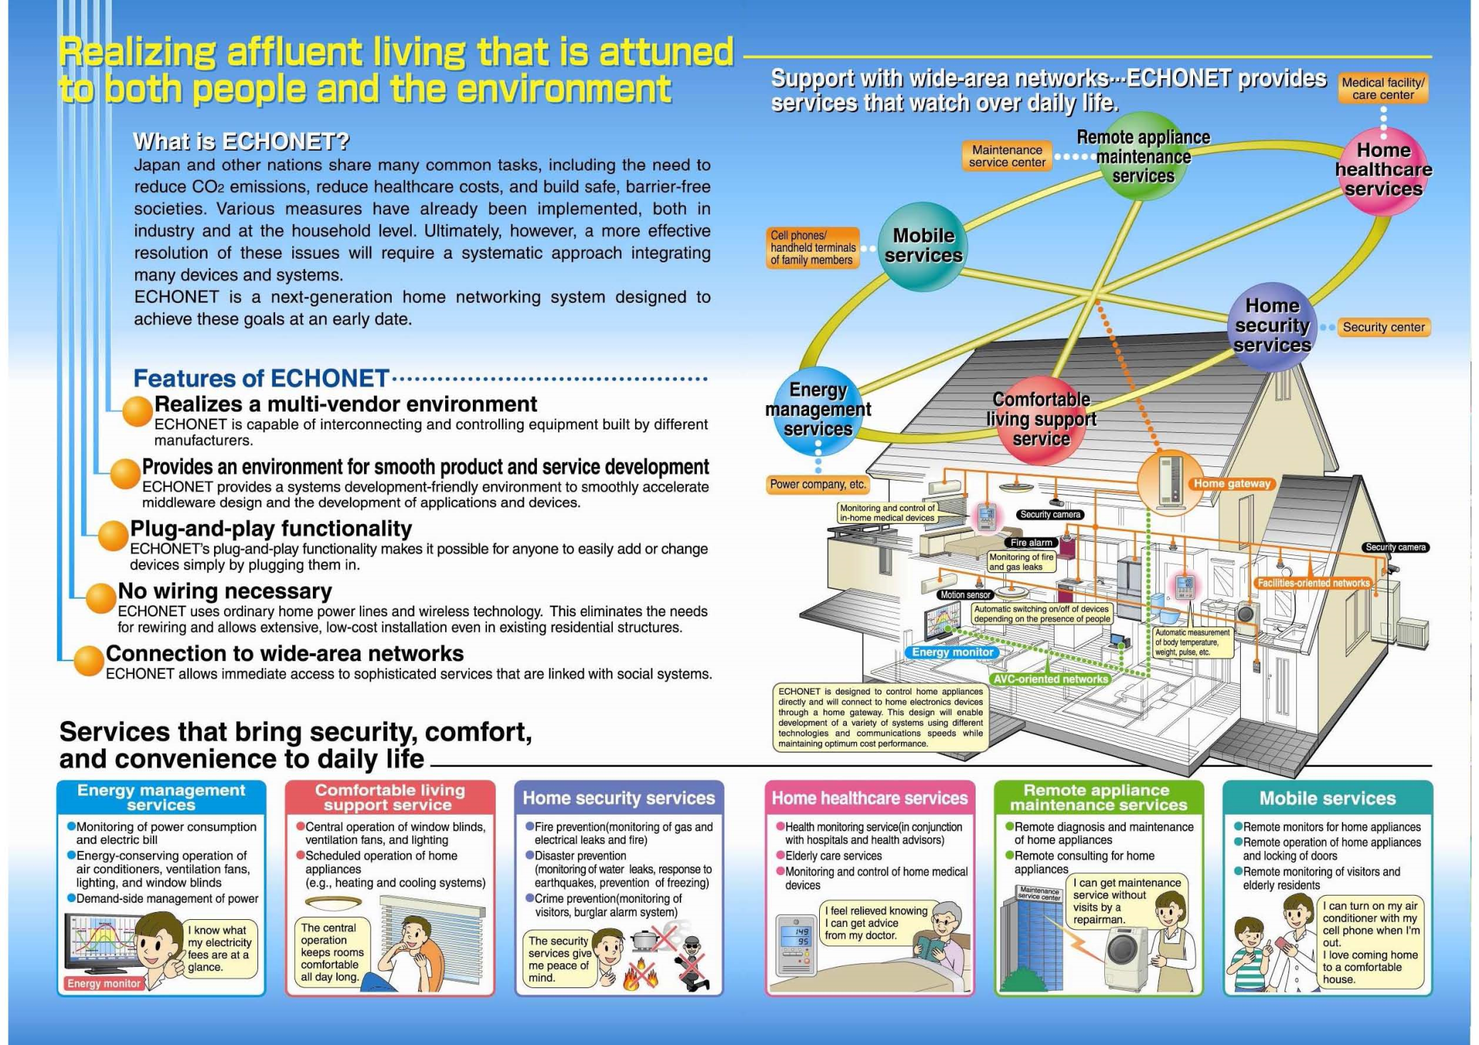

Slide 3
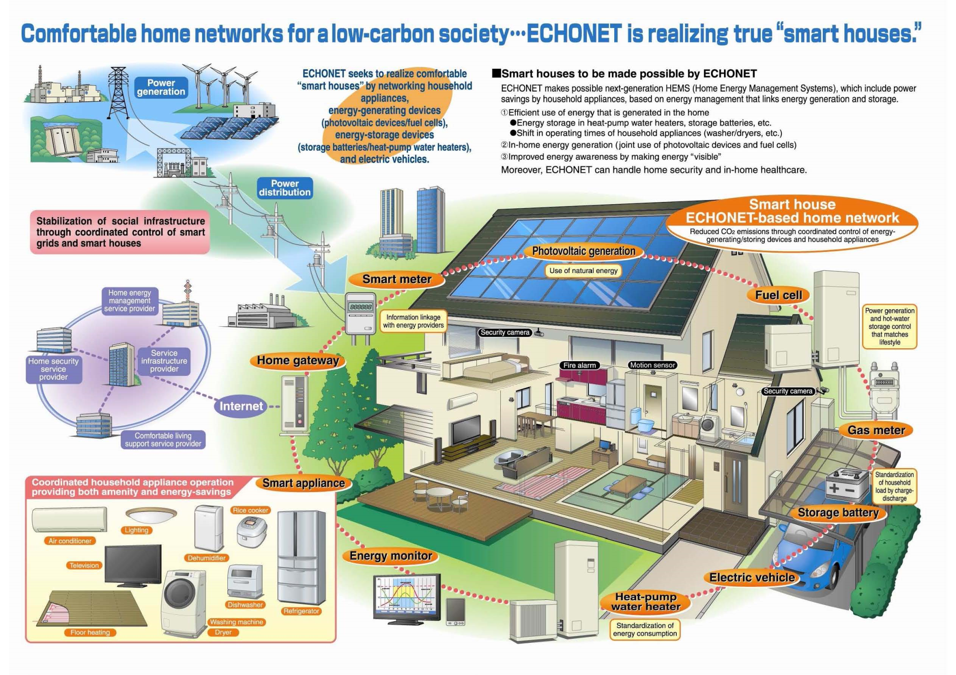

Slide 4
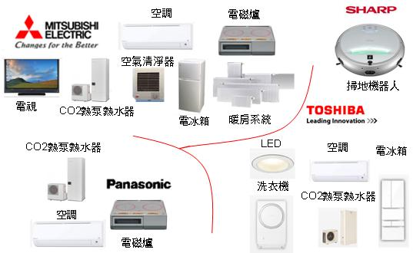
日本家電業者HEMS家電產品款式

Slide 5
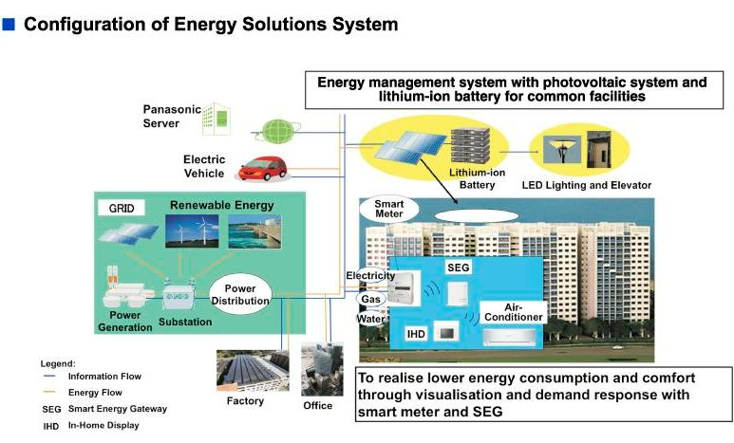

Slide 6
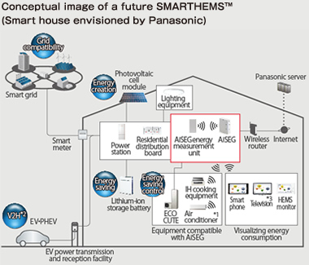

Slide 7
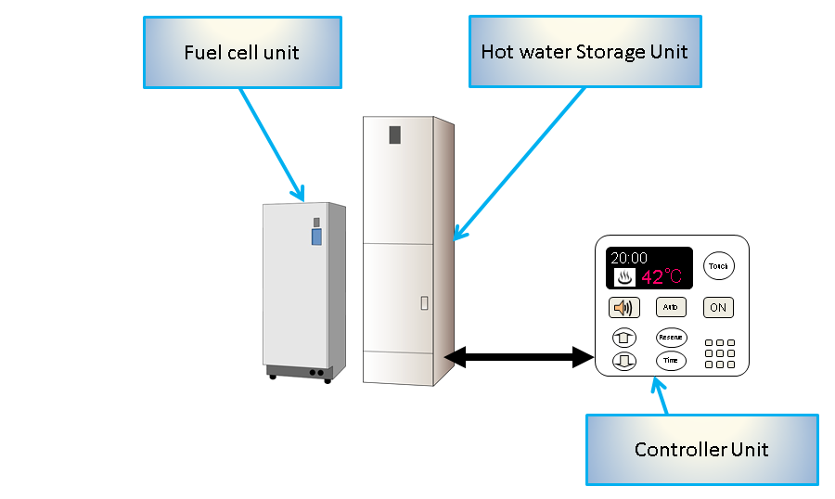
Panasonic Home Energy Management System: Total System Architecture

Slide 8
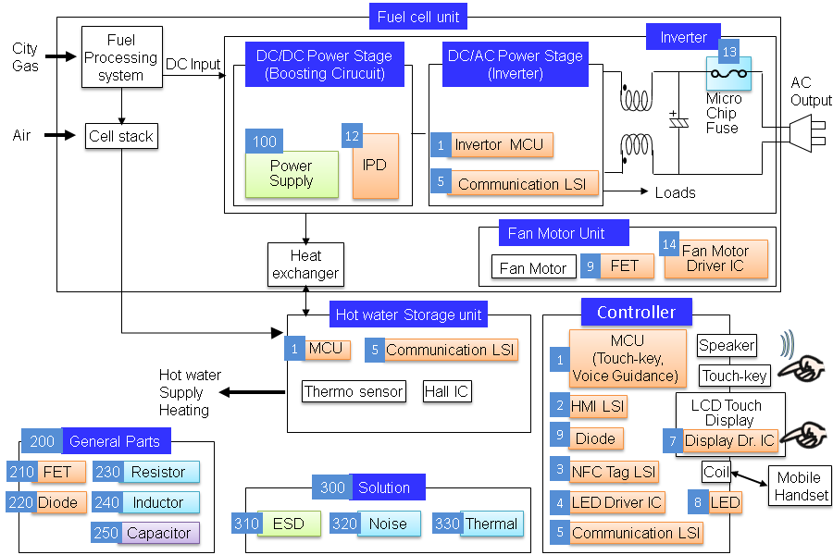
Panasonic Home Energy Management System: System Block Diagram

Slide 9
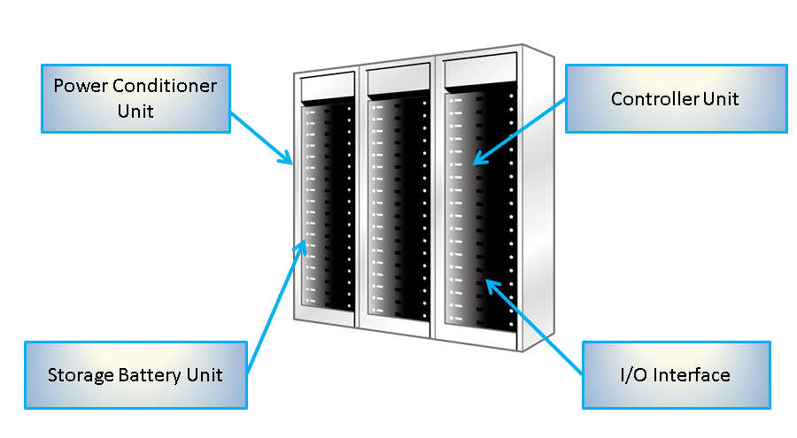
Panasonic Energy Storage System: Total System Architecture

Slide 10
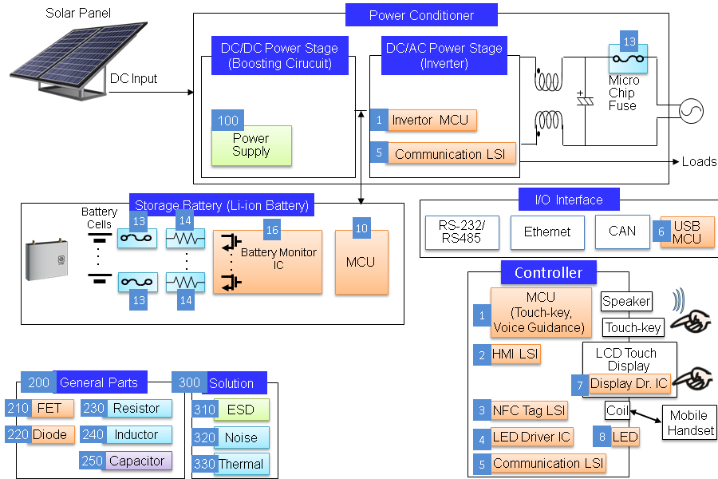
Panasonic Energy Storage System: System Block Diagram

Slide 11
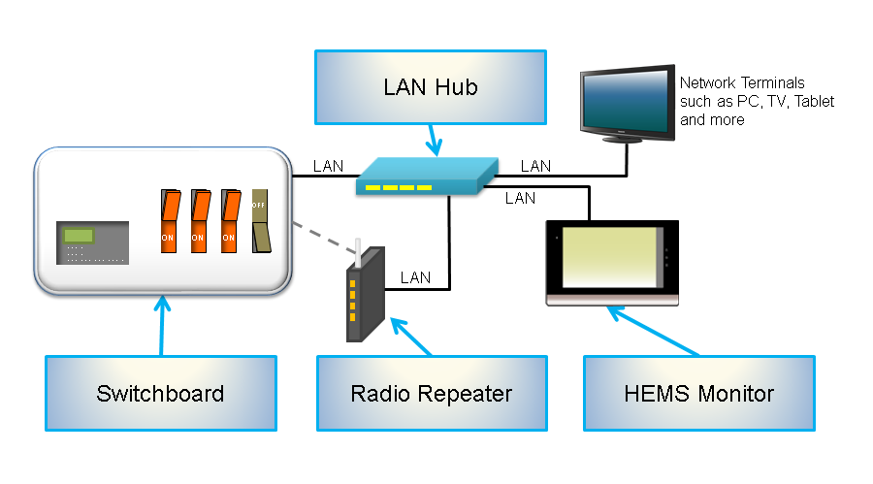
Panasonic Electric Switchboard: Total System Architecture

Slide 12
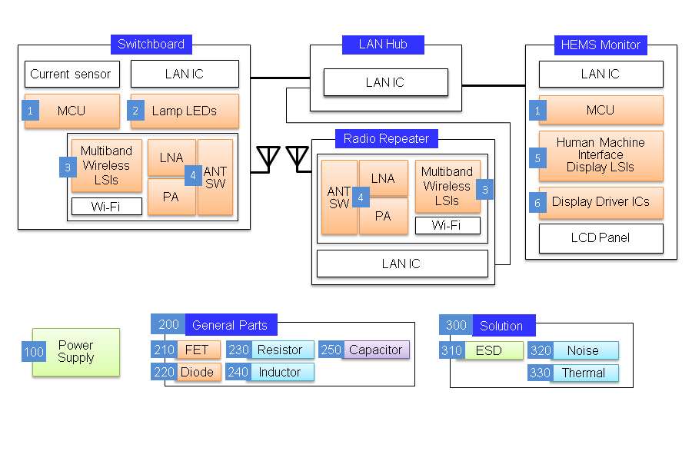
Panasonic Electric Switchboard: System Block Diagram

Slide 13
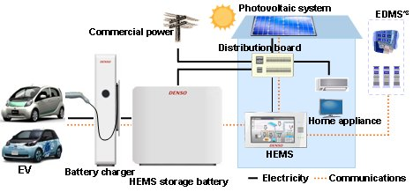
DENSO VEHICLE-TO-HOME (V2H) POWER SUPPLY SYSTEM

Slide 14
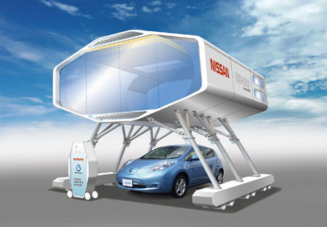
NISSAN STAND-ALONE ENERGY SYSTEM WITH‘LEAF TO HOME (V2H) ’(1)

Slide 15
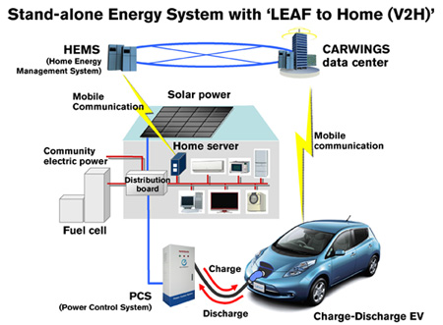
NISSAN STAND-ALONE ENERGY SYSTEM WITH‘LEAF TO HOME (V2H) ’(2)

Slide 16
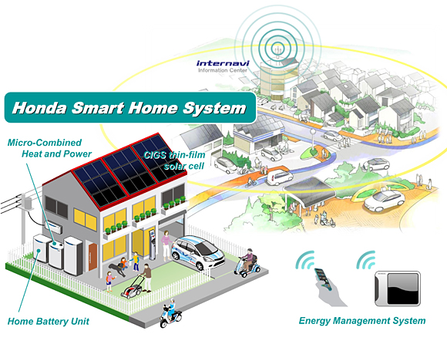
HONDA SMART HOME SYSTEM

Slide 17
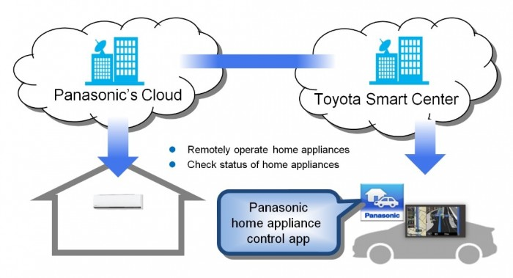
TOYOTA／PANASONIC HOME CONTROL SYSTEM

Slide 18
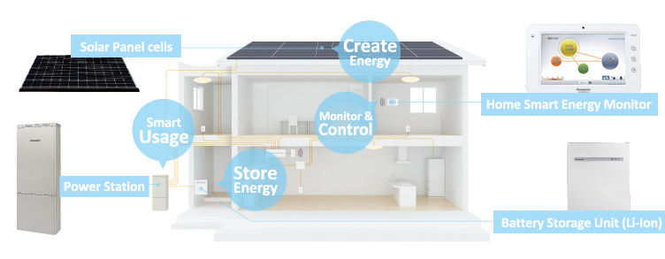
PanaHome SMART HEMS

Slide 19
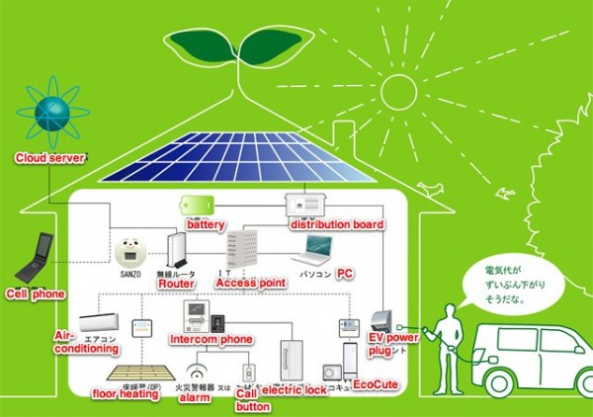
SANYO NETWORKED-HOME

Slide 20
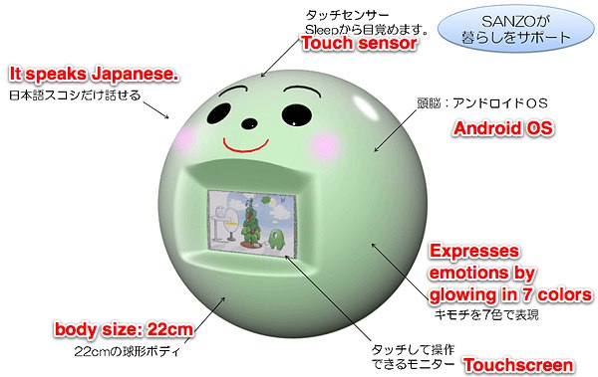
MIRAI SANZO：SANYO ANDROID-BASED SMART HOME ROBOT

Slide 21
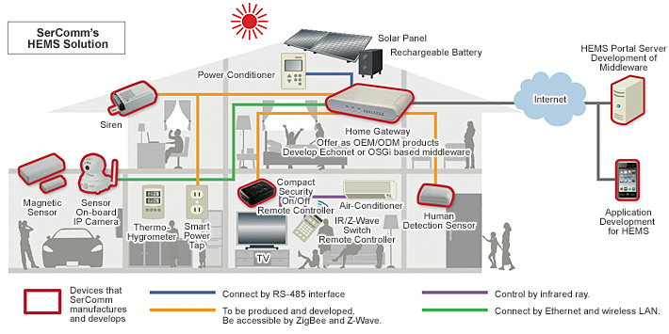
SerComm’s HEMS Solution

Slide 22
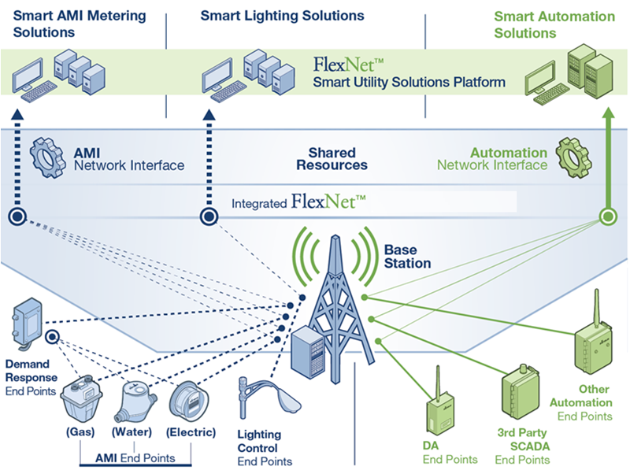
SENSUS MULTI-APPLICATION NETWORK

Slide 23
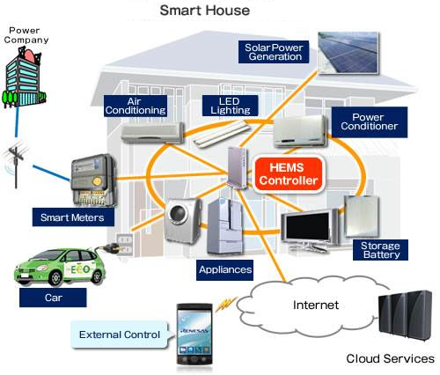
Renesas Smart Home (1)

Slide 24
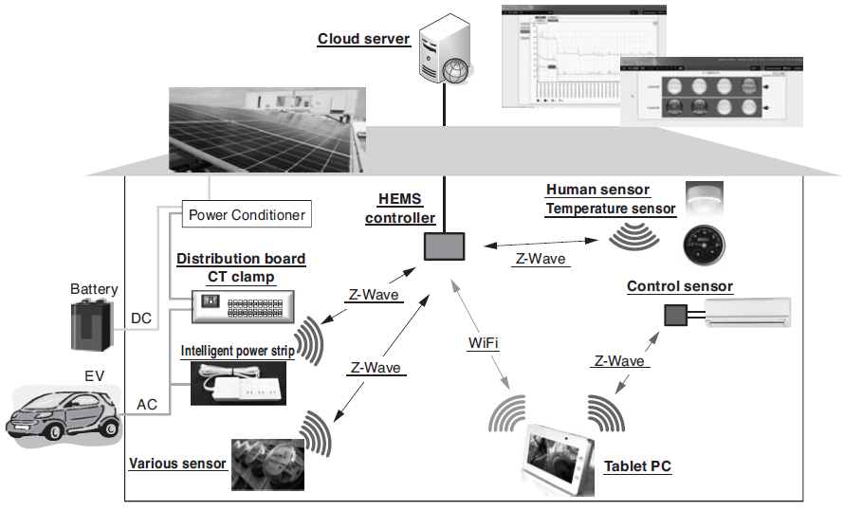
Home Energy Management System by Sumitomo Electric Industries, Ltd.

Slide 25
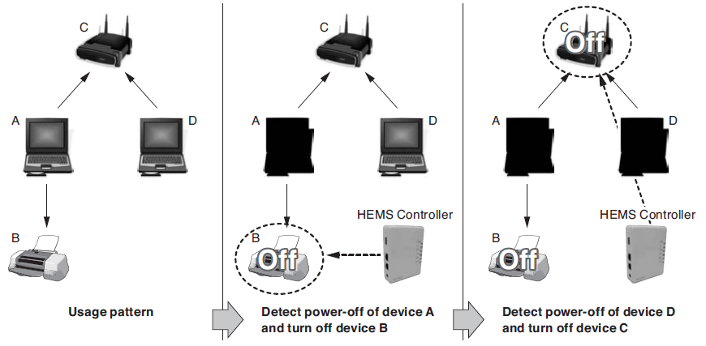
Example of Power Control by HEMS Controller (Sumitomo Electric Industries, Ltd.)

Slide 26
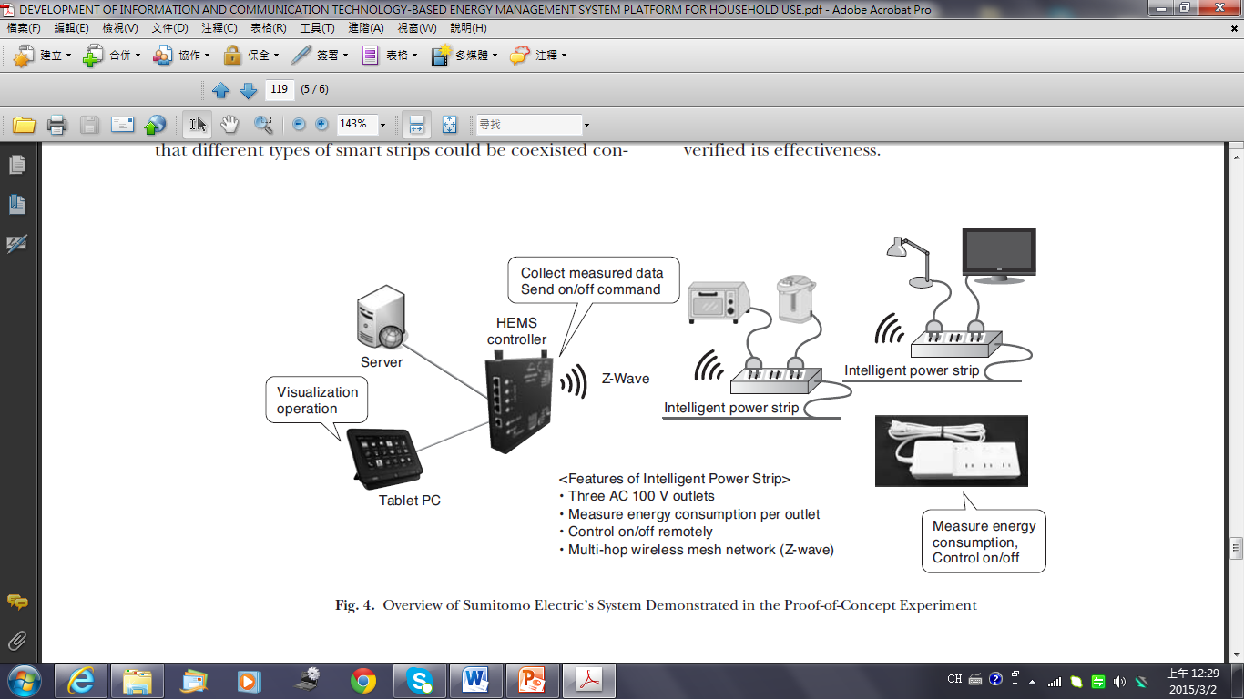
Overview of Sumitomo Electric’s System

Slide 27
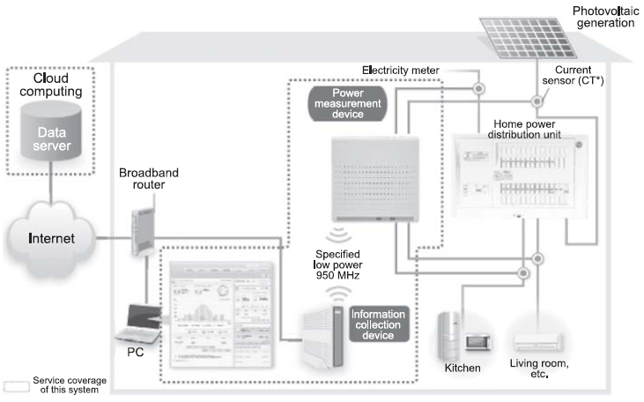
HEMS System Framework by NEC

Slide 28
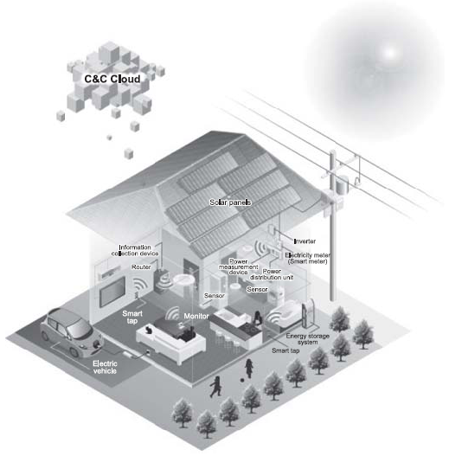
NEC Smart House

Slide 29
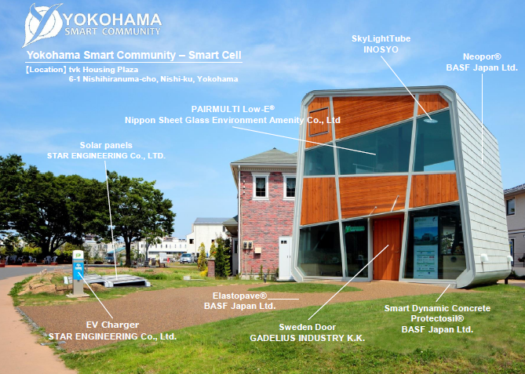
Yokohama Smart Cell (1)

Slide 30
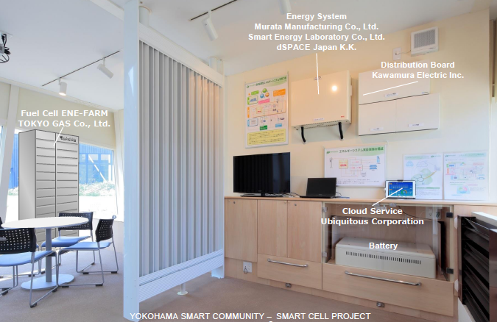
Yokohama Smart Cell (2)

Slide 31
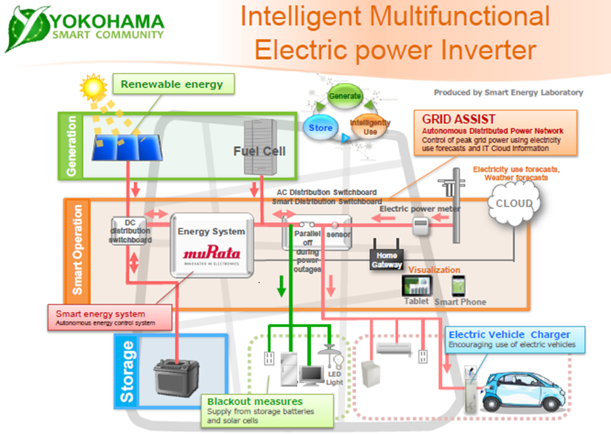

Slide 32
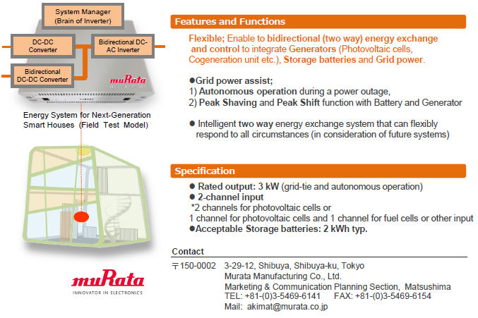

Slide 33
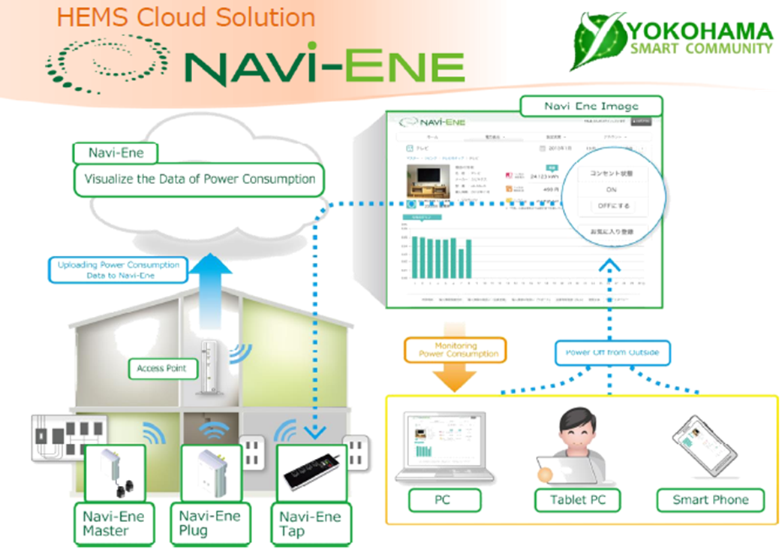

Slide 34
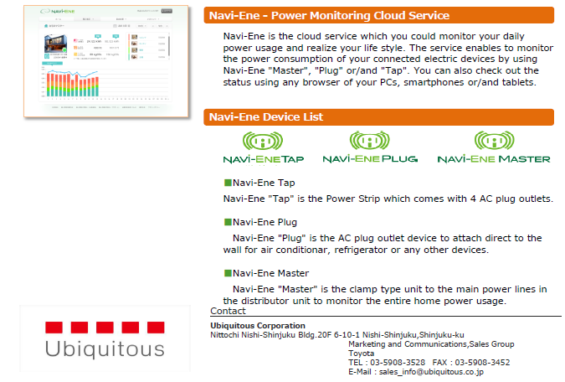

Slide 35
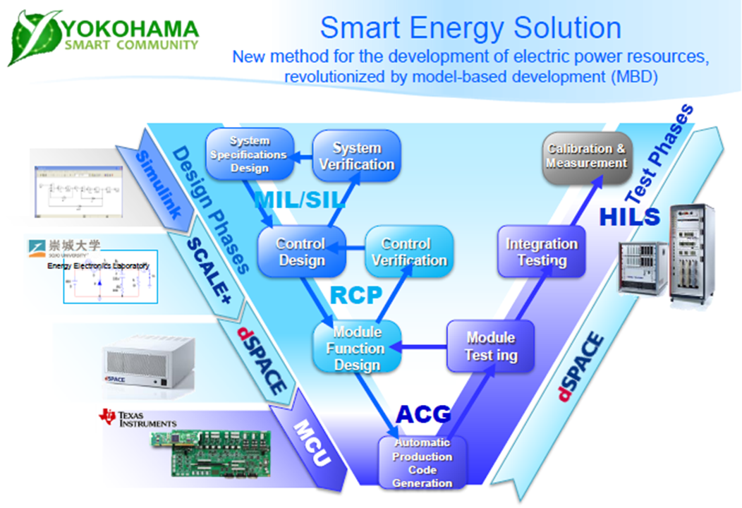

Slide 36
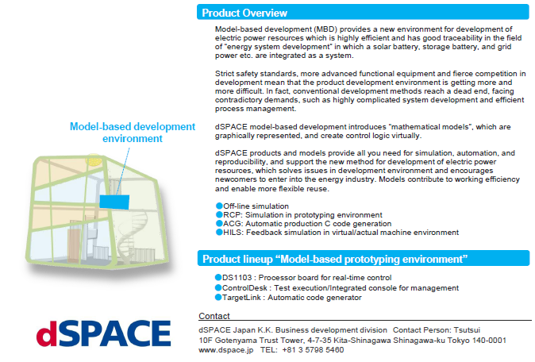

Slide 37
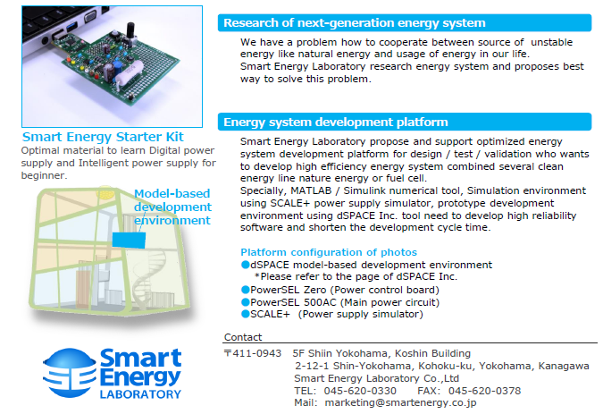

Slide 38
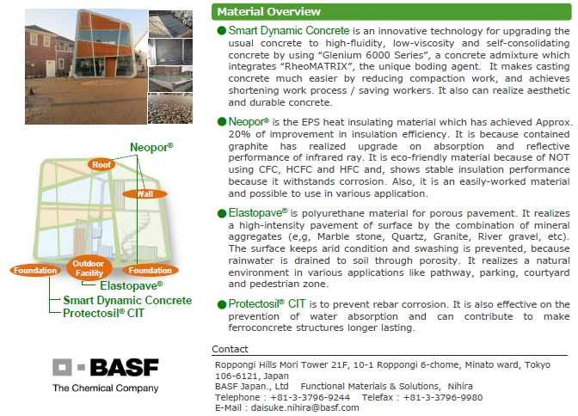

Slide 39
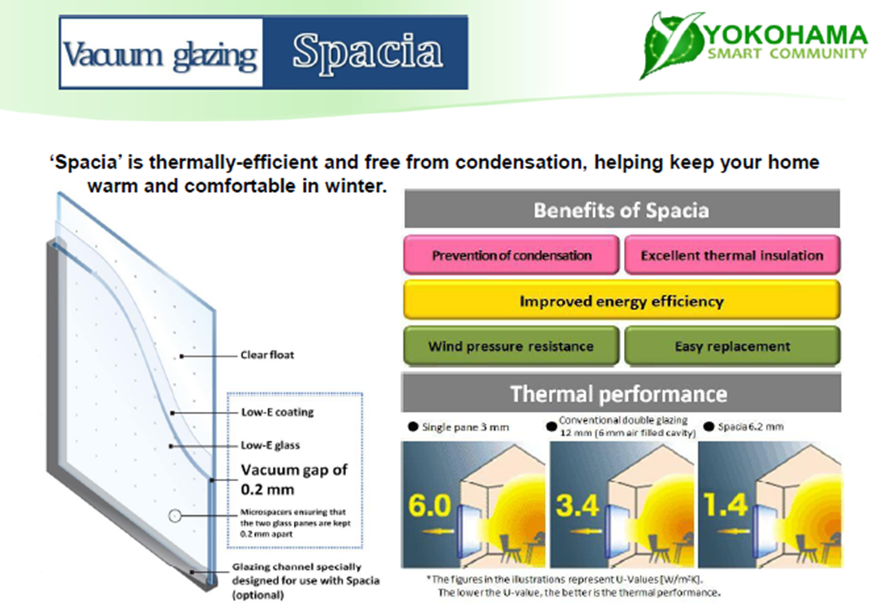

Slide 40
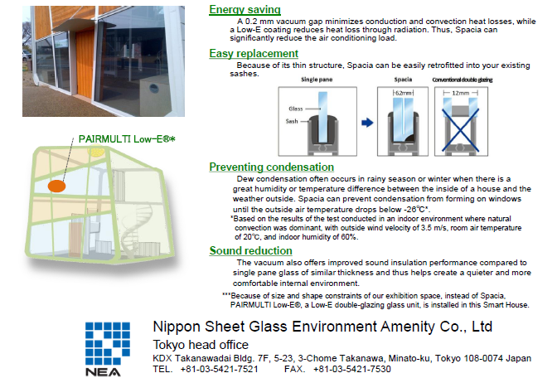

Slide 47
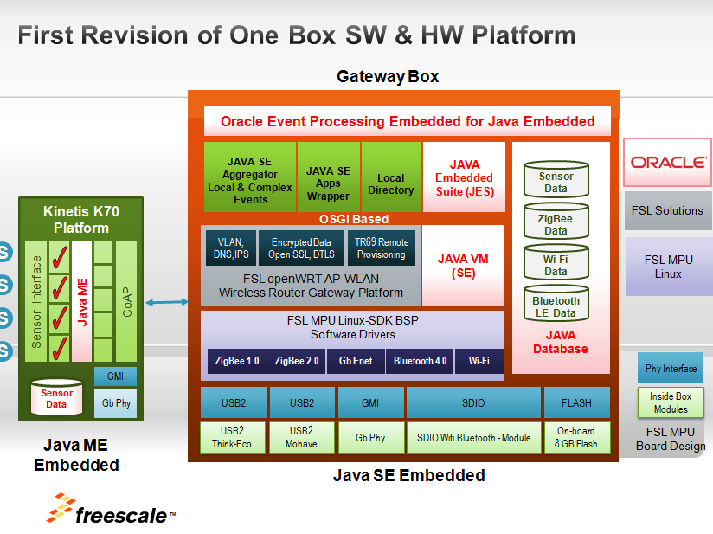

Slide 48
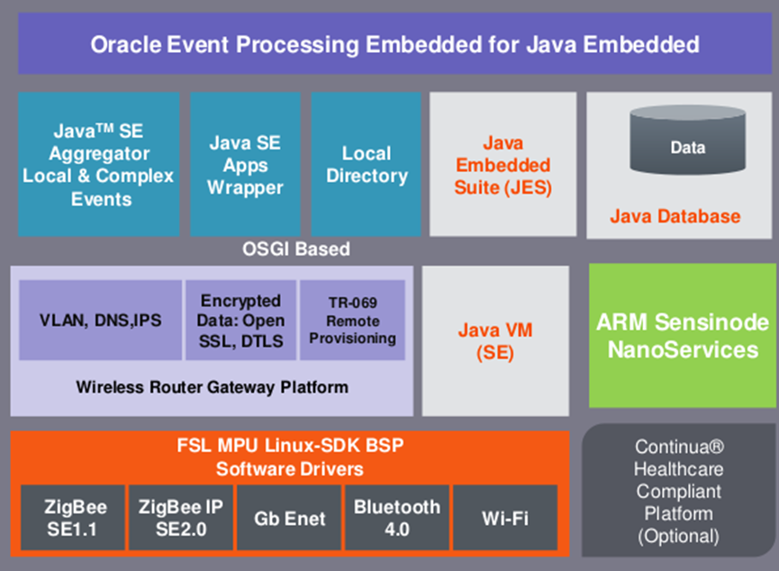
Oracle Event Processing (OEP) system

Slide 49
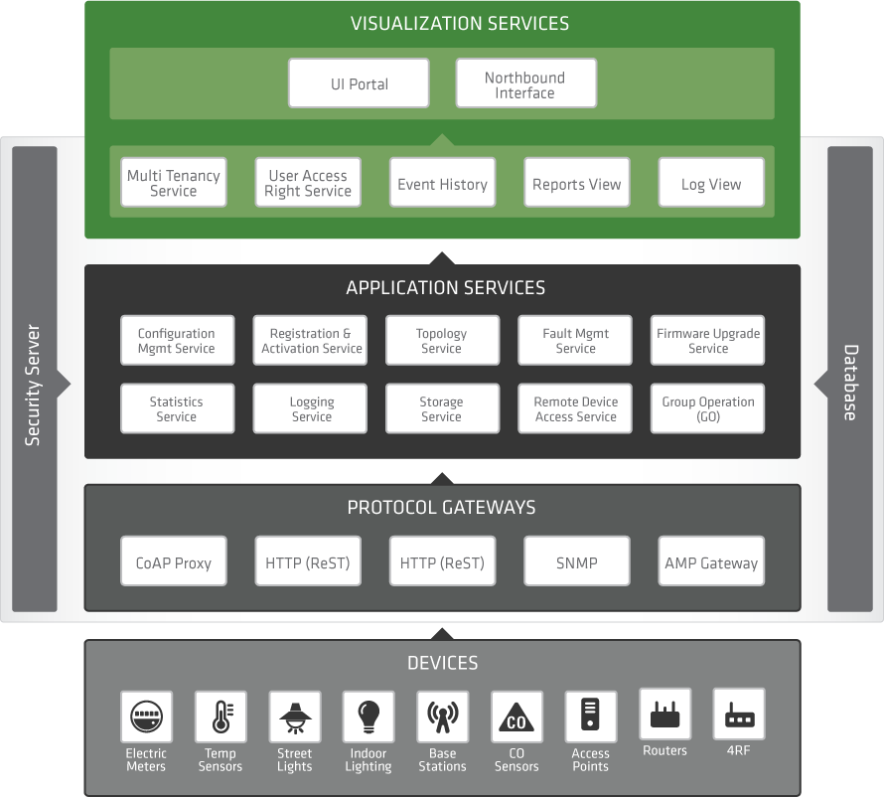
Cloud Connectivity Diagram for Kinetics Microcontrollers (MCUs)

Slide 50
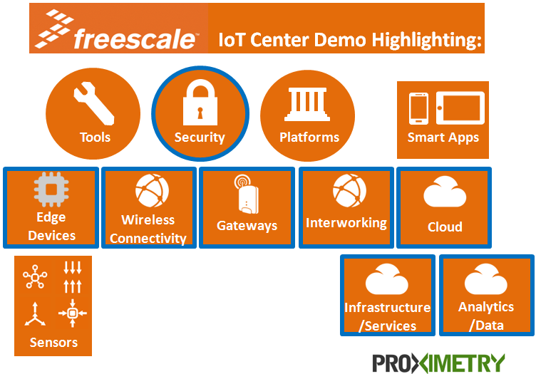
https://community.freescale.com/community/iot-center/demos/proximetry-demo-page

Slide 51
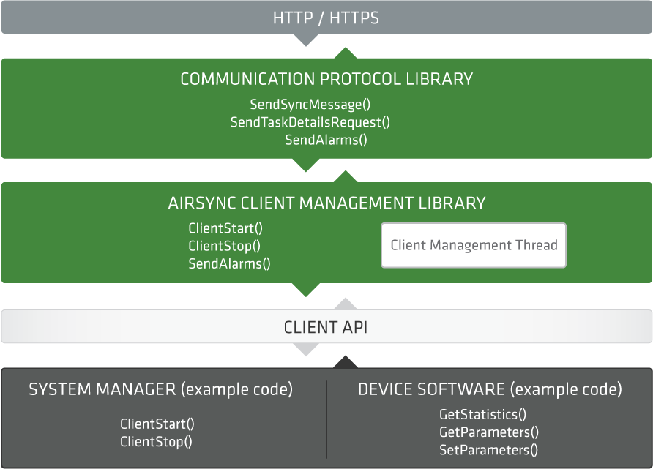
Software Block Diagram：AirSync™ Agent SDK

Slide 52
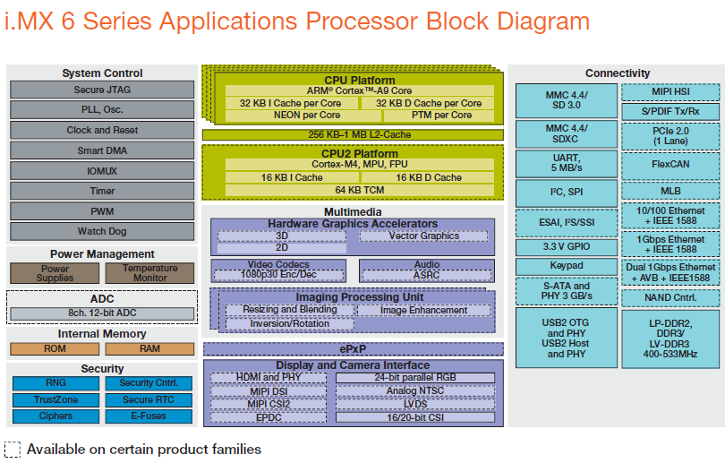

Slide 53
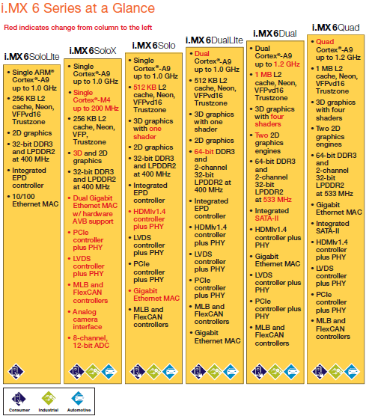

Slide 54
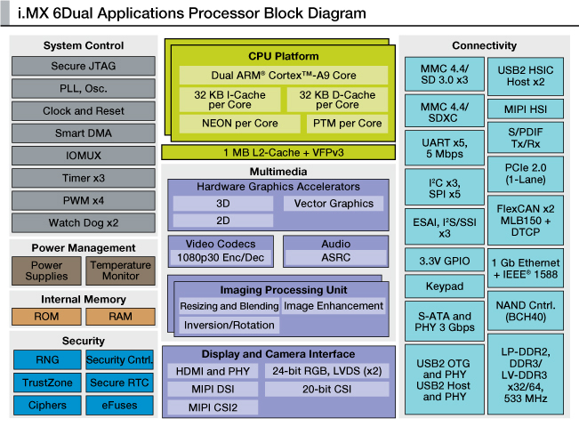

Slide 55
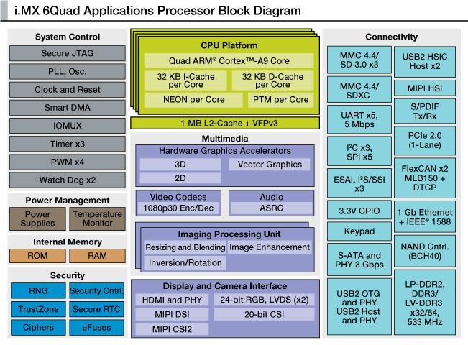

Slide 56
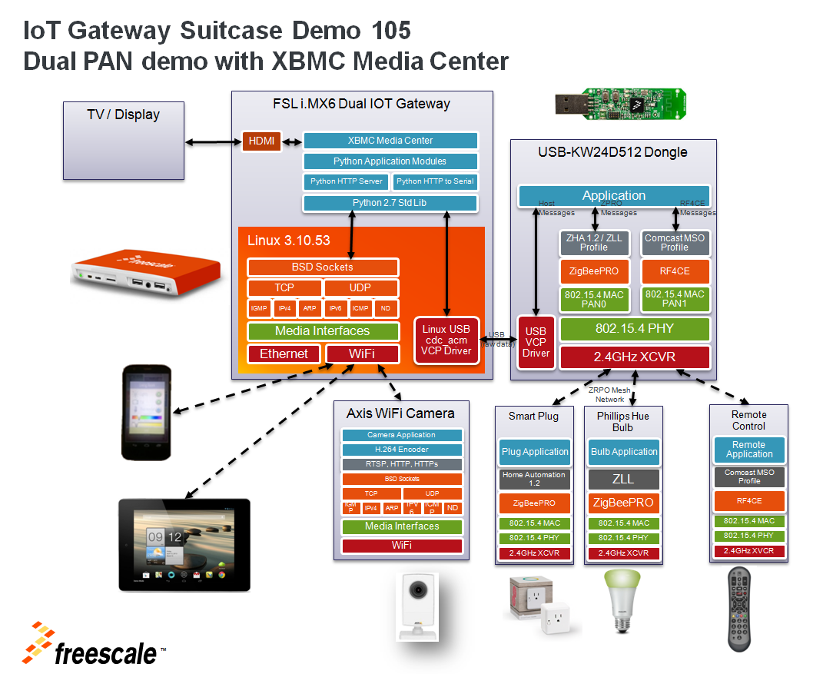

Slide 57
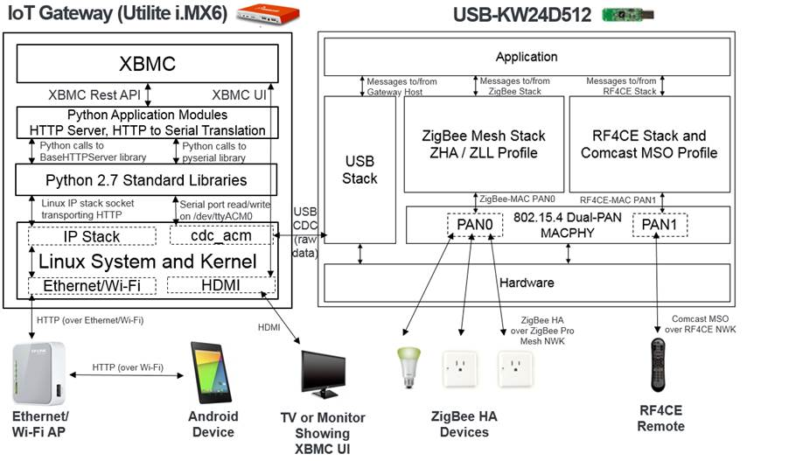
Under construction

Slide 58


Slide 59


Slide 60


Slide 61


Slide 62


Slide 63


Slide 64


Slide 65


Slide 66


Slide 67


Slide 68

Secure Debug and Client／Server Authentication

Slide 69


AES 128-bit Encryption/Decryption

Slide 70

HAN Standards and Security Algorithm

